Slide 1
Case Study for Cyclistic
By: Jeff Lin

Slide 2
The Problem:
How do annual members and casual riders use Cyclistic bikes differently?
Why would casual riders buy Cyclistic annual memberships?
How can Cyclistic use digital media to influence casual riders to become members?
This PowerPoint will cover the first problem

Slide 3

How do they differ? Why does it matter?

Slide 4
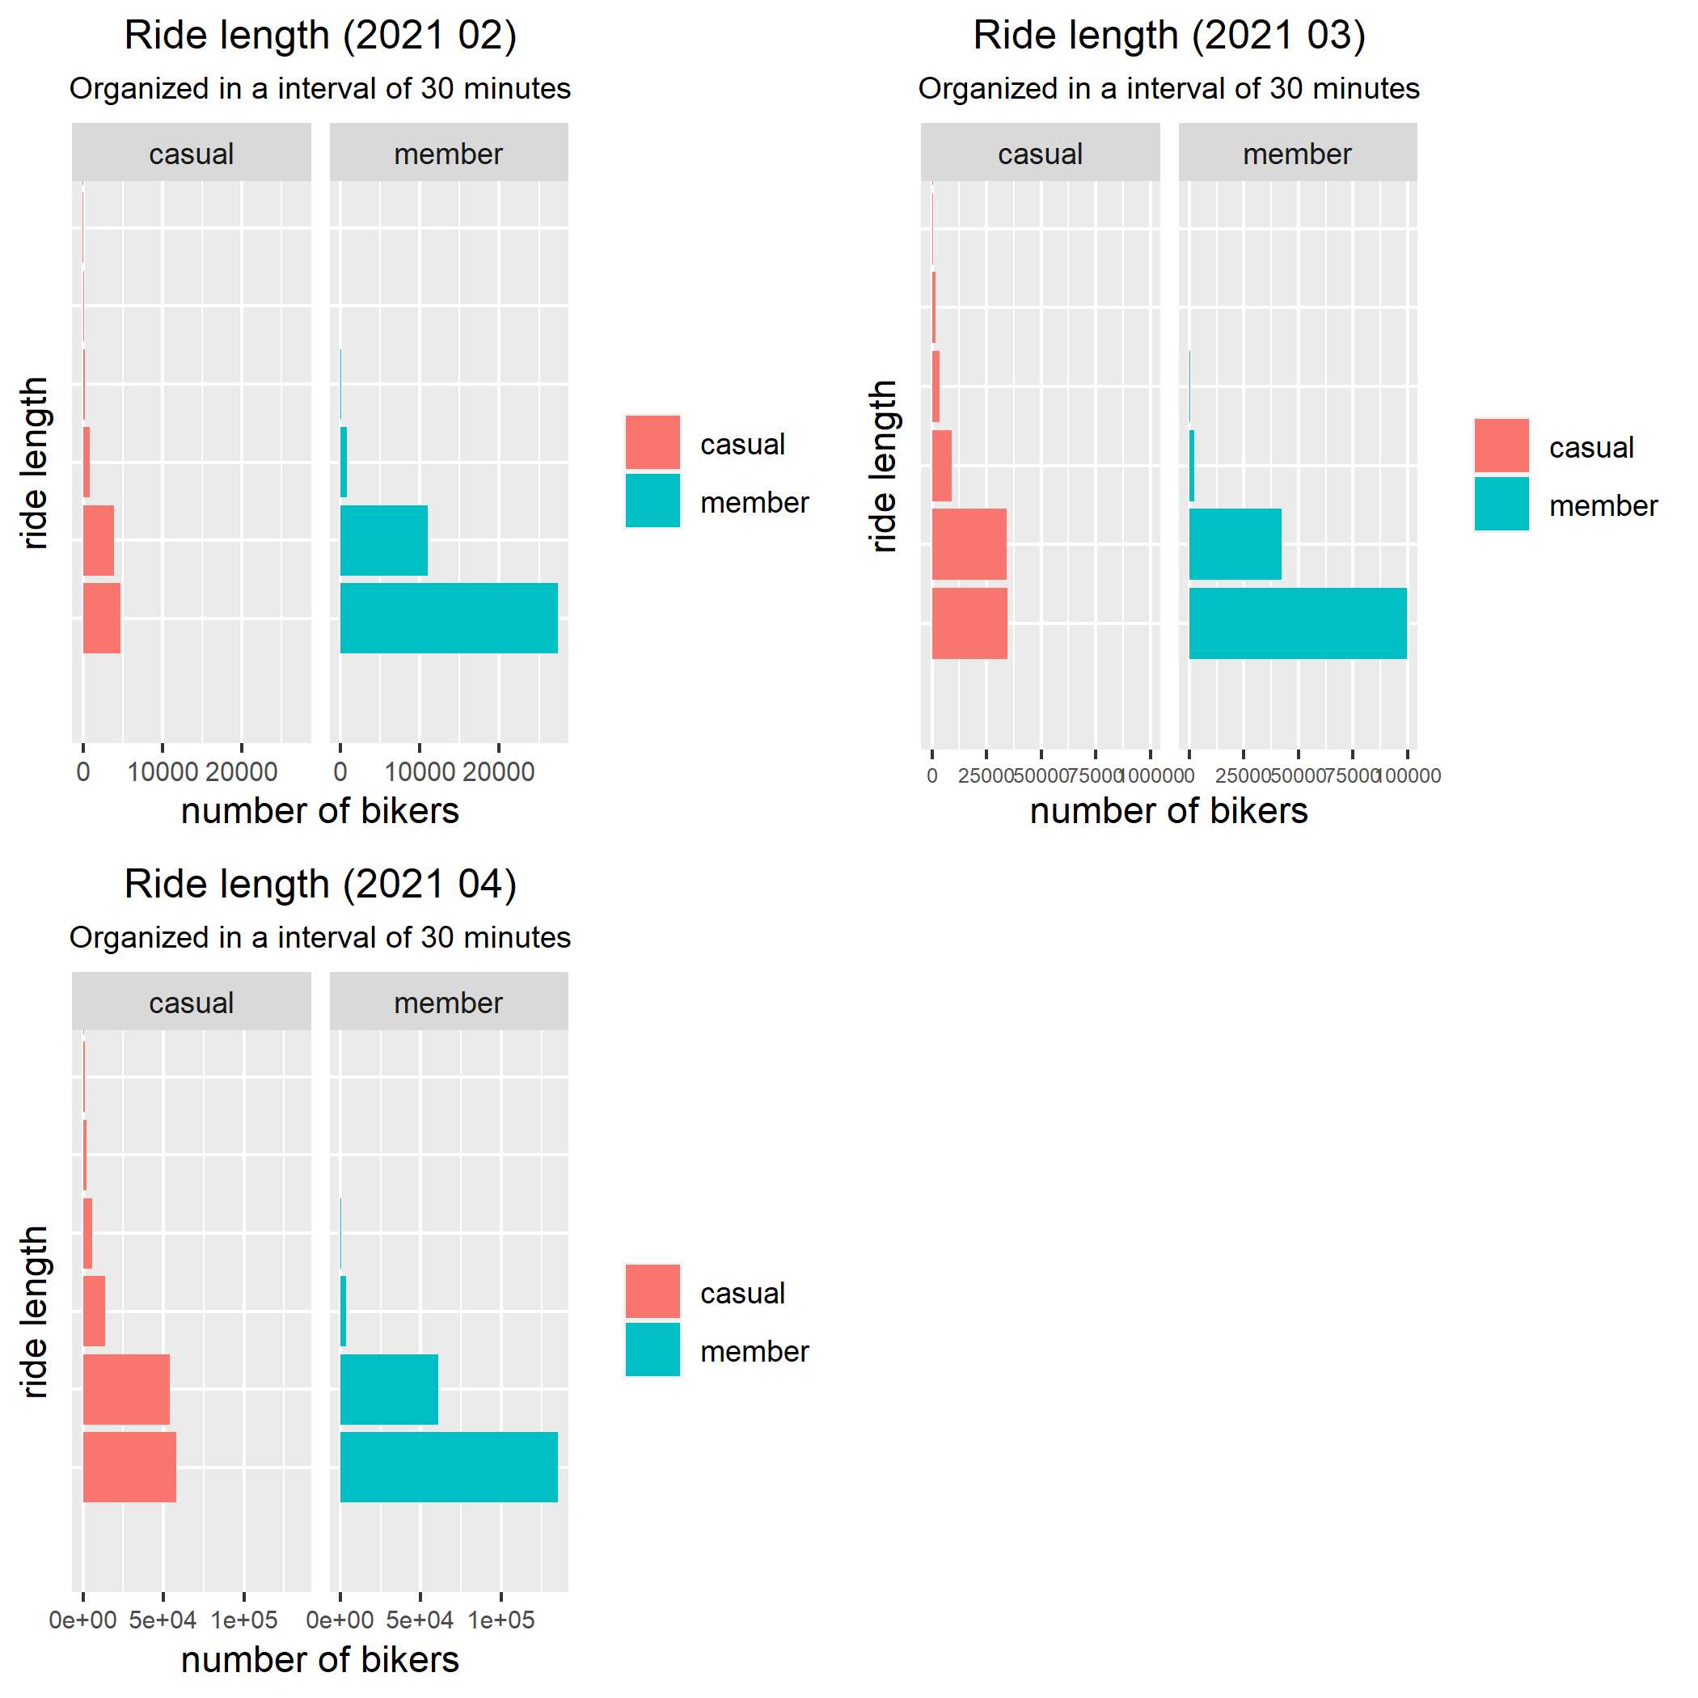
Ride length of Casual vs. members
The time interval is arranged by 30 minutes.
First bar less than 30 minutes, second around 30 minutes, third around an hour, etc.

Slide 5
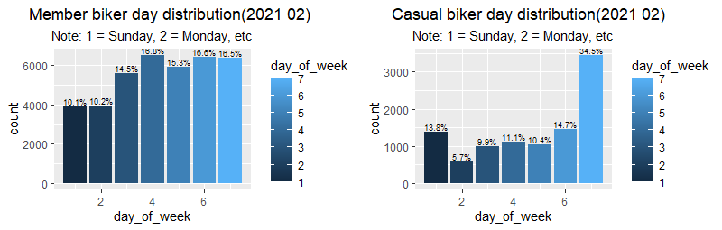
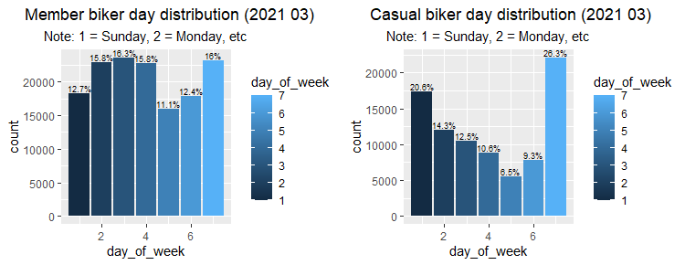
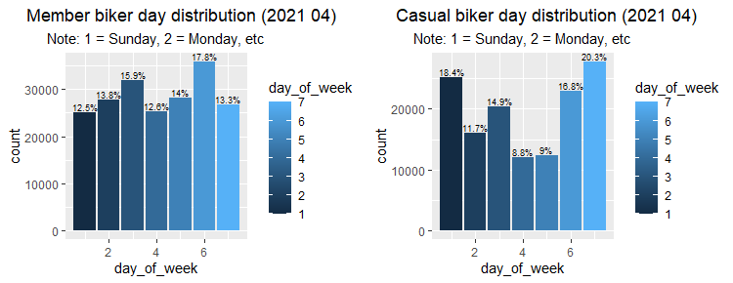
Day Distribution of a Week

Slide 6
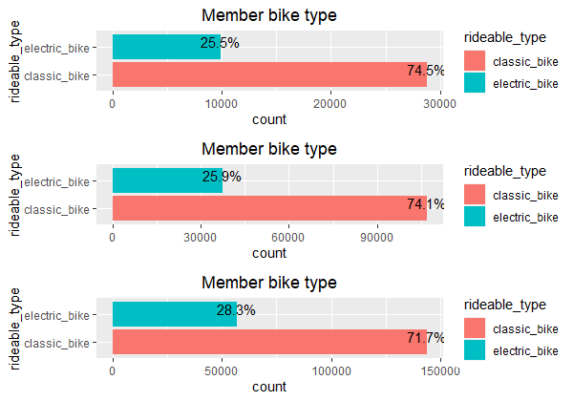
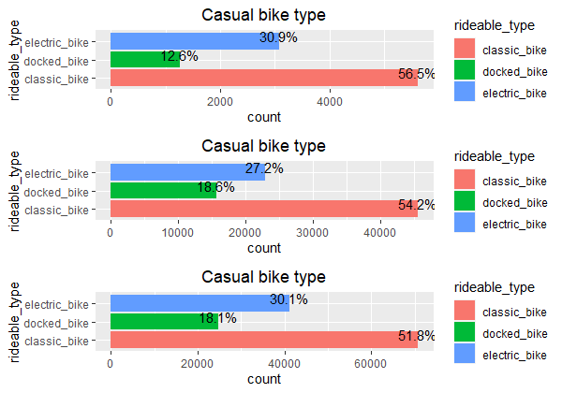
Bike type distribution

Slide 7
How do they differ? Why does it matter?

Slide 8

Why do these graphs matter?
By examining these graphs, there are some key difference between casual and member riders.
By utilizing the stories these graphs are telling, there is a higher chance of converting casual riders to an annual member.

Slide 9
Solutions:
We can generate targeted ad for casual riders who spend less than 30 minutes per ride.
Because most members spend < 30 minutes per ride, we can safely assume that casual riders who spend < 30 minutes per ride can be a potential member.
Due to a higher percentage of electric bike and docked bike usage in casual bikers, we can create a new membership that benefits electric and docked bike users.
This can potentially convert up to 50% casual bikers to members.
Due to the majority of casual bikers' bike during the weekends, we can give special benefits for signing up over the weekend such as 10% off if signed up over weekend.

Slide 10
Thank you for listening
All the data is collected from divvy-tripdata, an online public dataset
Further analysis can be conducted such as why casual bikers choose docked bike
Email: linjeff16@gmail.com

